Slide 1


POROUS MEDIUM HEATED FROM BELOW
SCIENTIFIC COMPUTING ASSIGNMENT
Authors:
Presented to:
Volodymyr Yelnyk
Ferran de Andrés
Ferhat Sindy
Juergen Fuhrmann
April 19, 2022

Slide 2
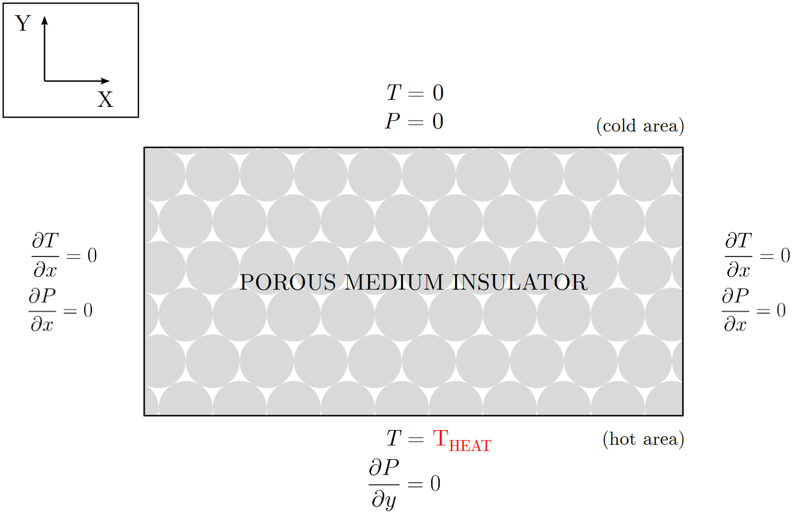

Introduction. Physical background.
Section title
Porous medium saturated with water and heated from below
Interest in geophysical applications, insulation materials and solar energy.
Simplified 2D domain and boundary conditions
Figure 1. Porous medium insulator system representation
1/18

Slide 3
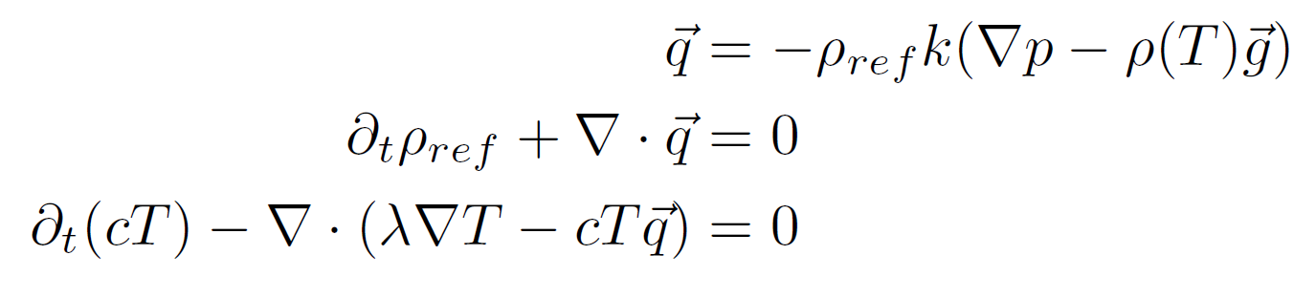

Introduction. Model.
Section title
System of Darcy’s equation with Boussinesq approximation:
Density variations induced by variations in T and/or solute are neglected (except for gravity)
All other material properties are assumed constant
Viscous dissipation is assumed negligible
Linearized state equation
Darcy’s law
Mass conservation
Energy conservation
2/18

Slide 4
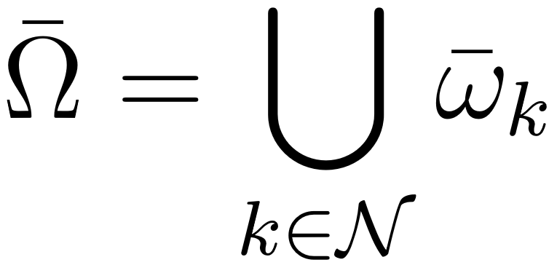
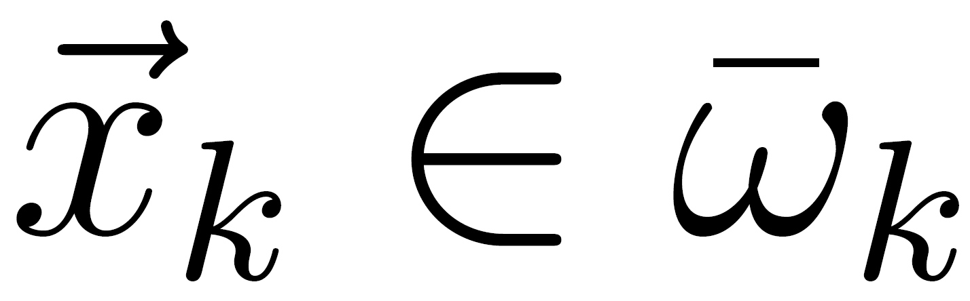
Discretizing the problem
Section title
Method of lines
Space discretization: FVM
Time discretization: Implicit Euler and other more sophisticated time-stepping methods (Rodas5)
Control volumes:
Divide domain (meshing):
Assign collocation points:
Placement of collocation points:
Admissibility condition
Placement of boundary unknowns
3/18

Slide 5
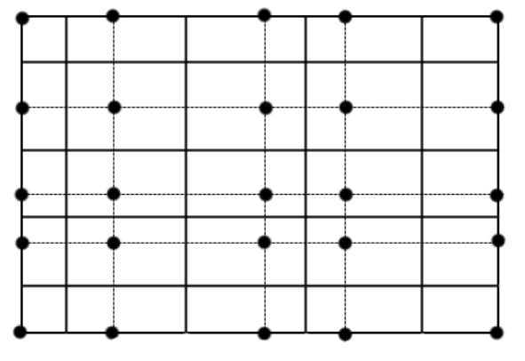
Discretizing the problem. Space discretization
Section title
Regular grid:
Figure 2. General regular grid in 2D
4/18

Slide 6
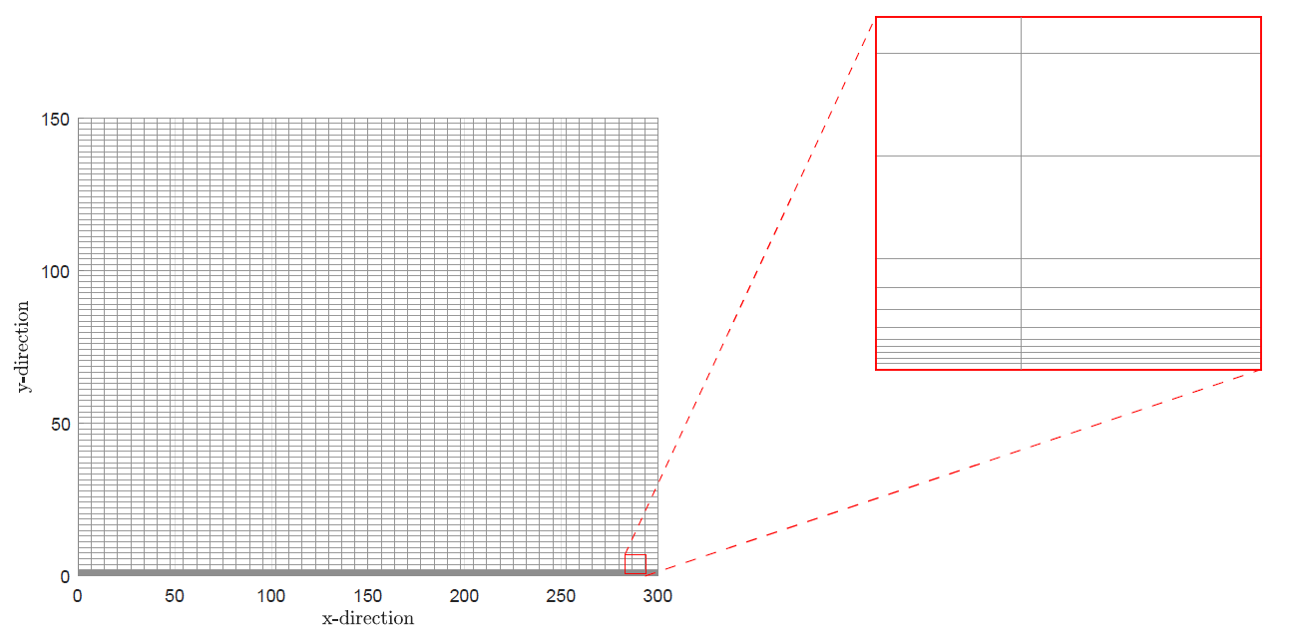
Discretizing the problem. Space discretization
Section title
Refinement at boundary layer:
Figure 3. Regular mesh of the domain with a close up of local refinement at the bottom boundary
5/18

Slide 7
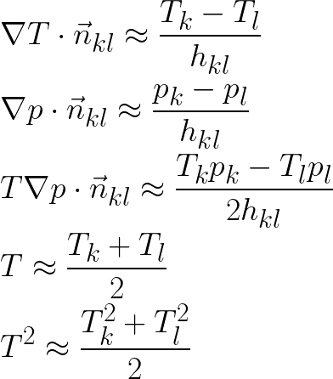
Discretizing the problem. Space discretization
Section title
Equation discretization:
6/18

Slide 8
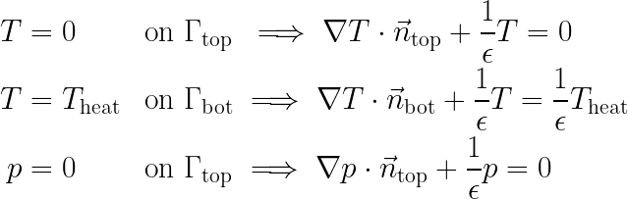
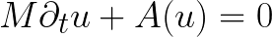
Discretizing the problem. Space discretization
Section title
Boundary conditions. Penalty method:
Result: large ODE system.
7/18

Slide 9
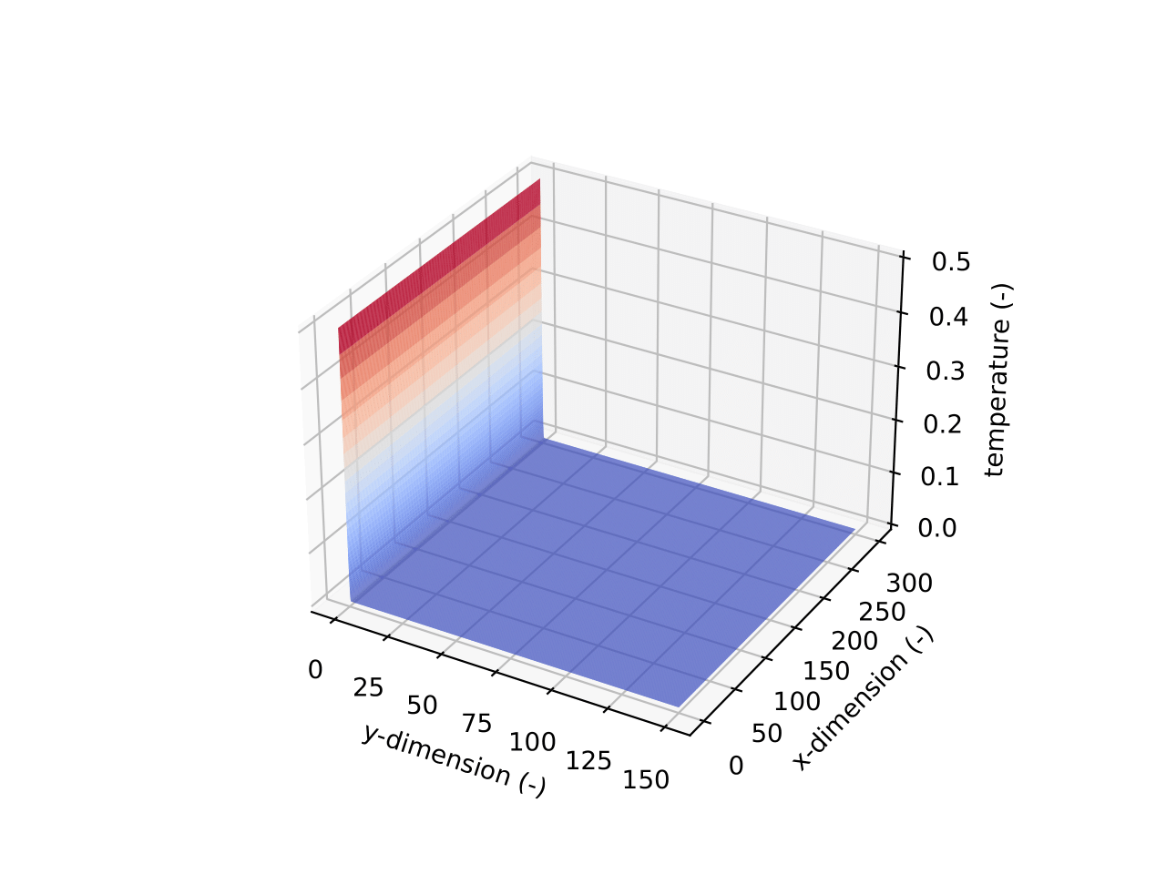
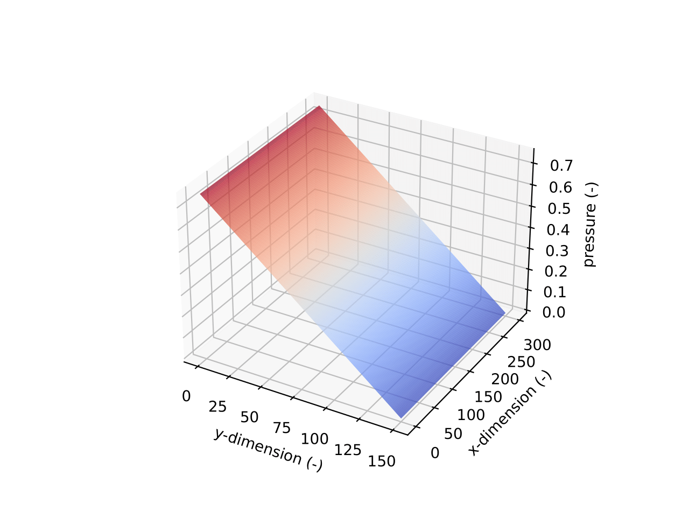
Solution and results. Steady state.
Section title
1D vs 2D solver (T at bottom = 0.5)
Figure 4. Steady state distributions of temperature (left) and pressure (right)
8/18

Slide 10
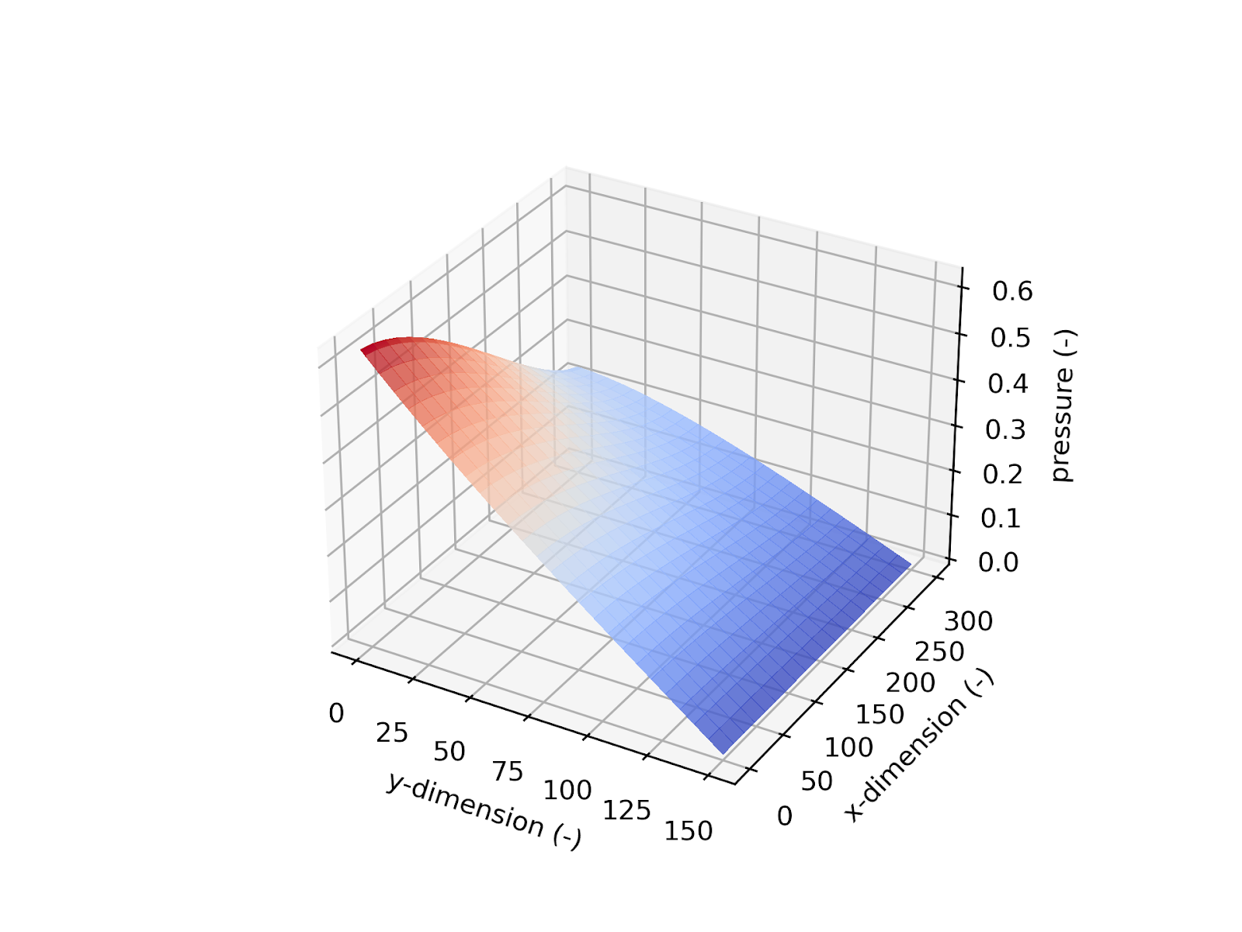
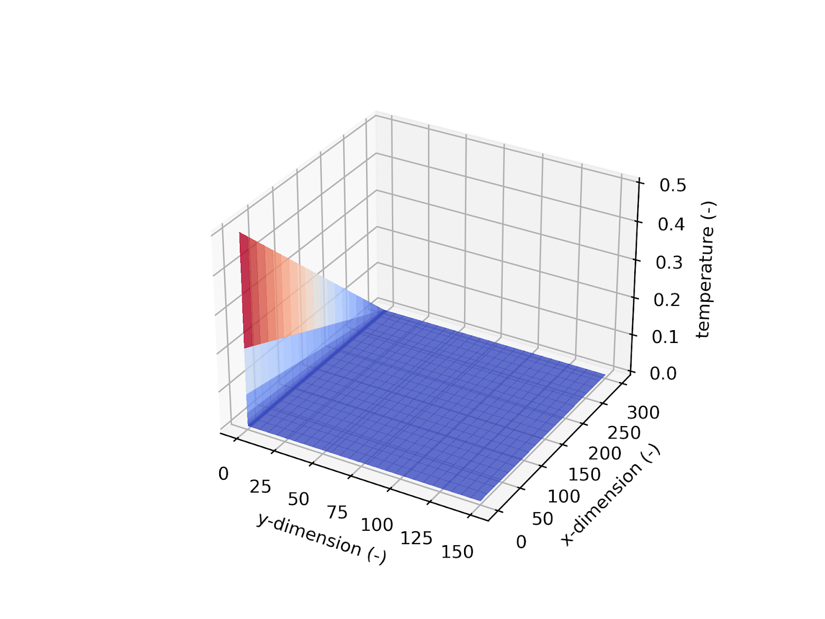
Solution and results. Steady state.
Section title
Different boundary conditions (2D solver)
Figure 5. Steady state distributions of temperature (left) and pressure (right) with different boundary conditions at the bottom
9/18

Slide 11
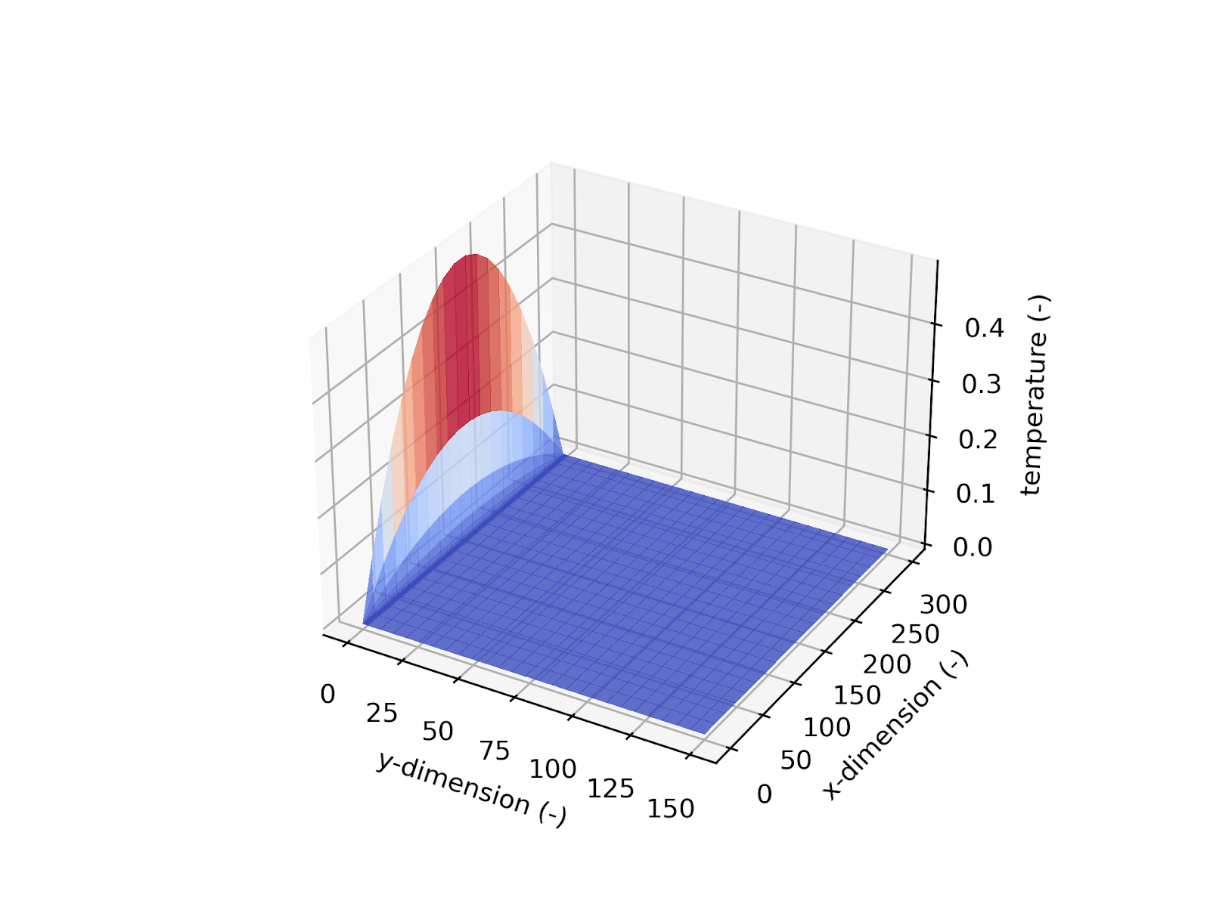
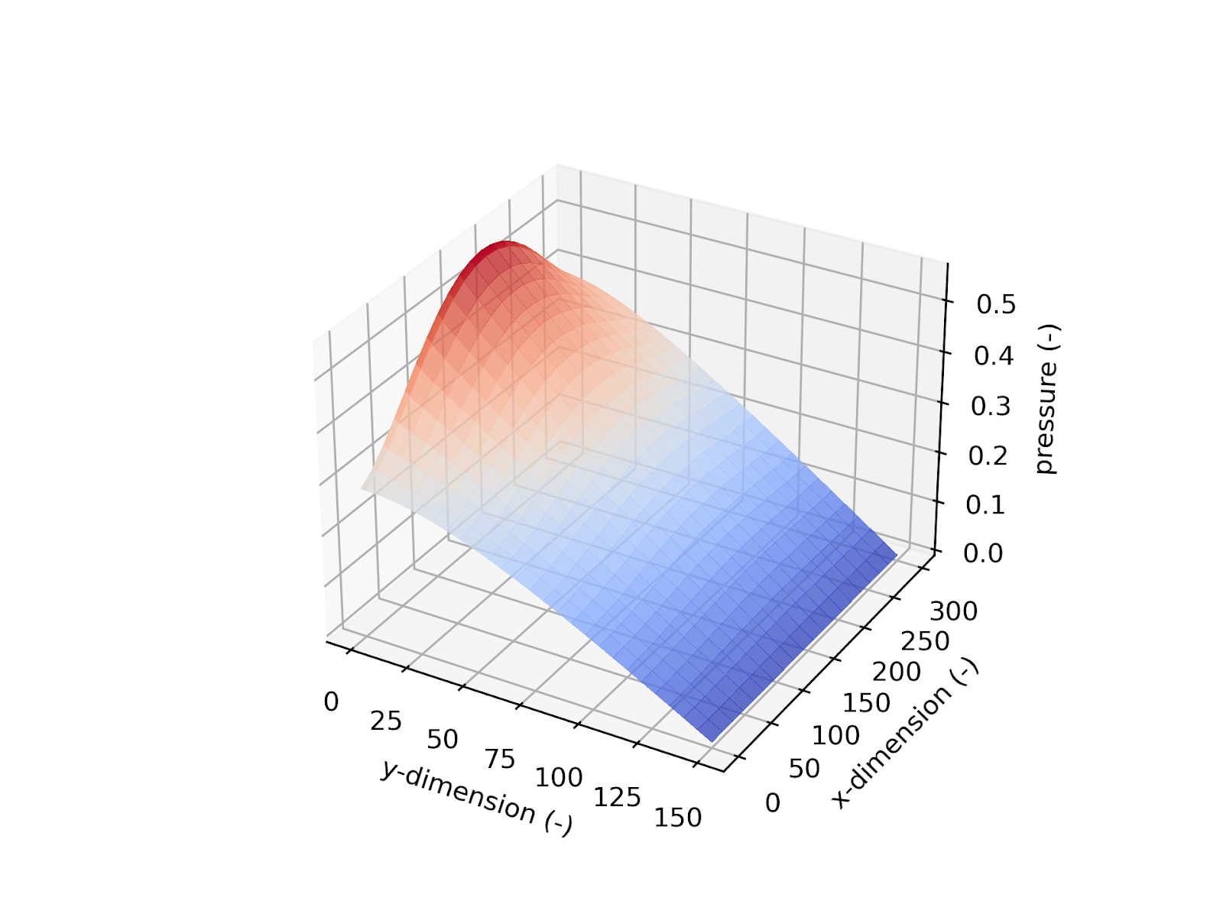
Solution and results. Steady state.
Section title
Different boundary conditions (2D solver)
Figure 5. Steady state distributions of temperature (left) and pressure (right) with different boundary conditions at the bottom
10/18

Slide 12
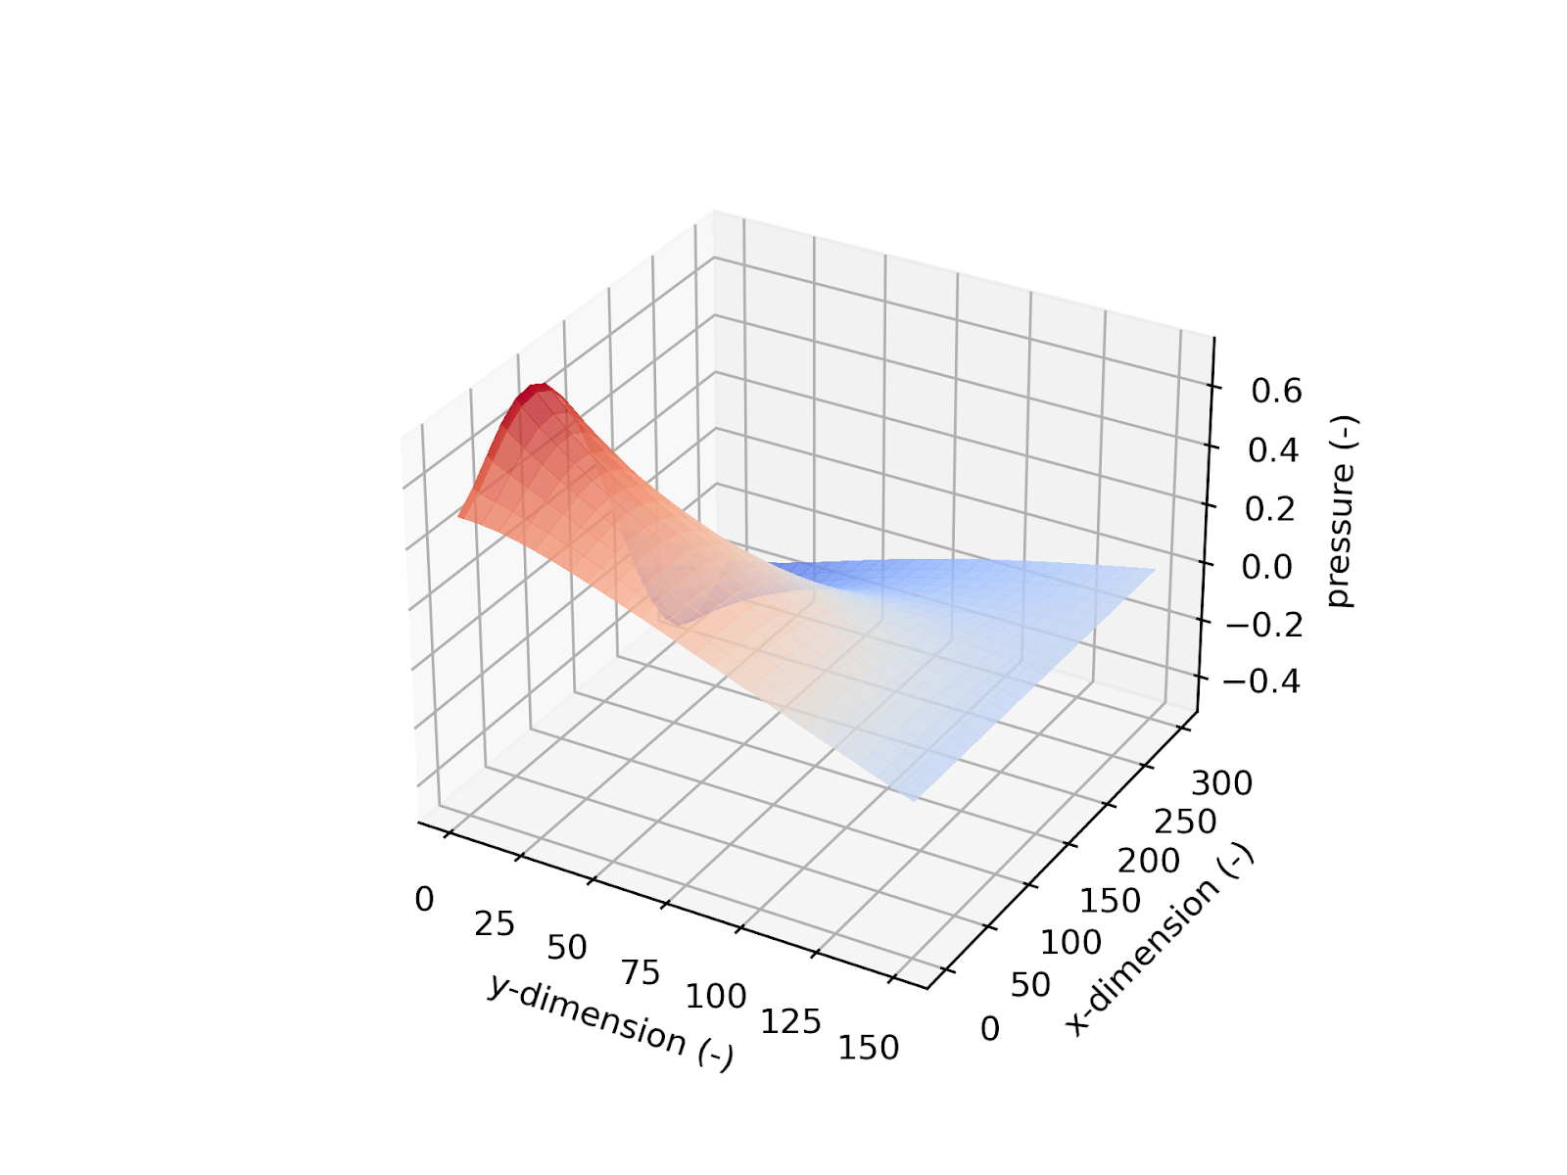
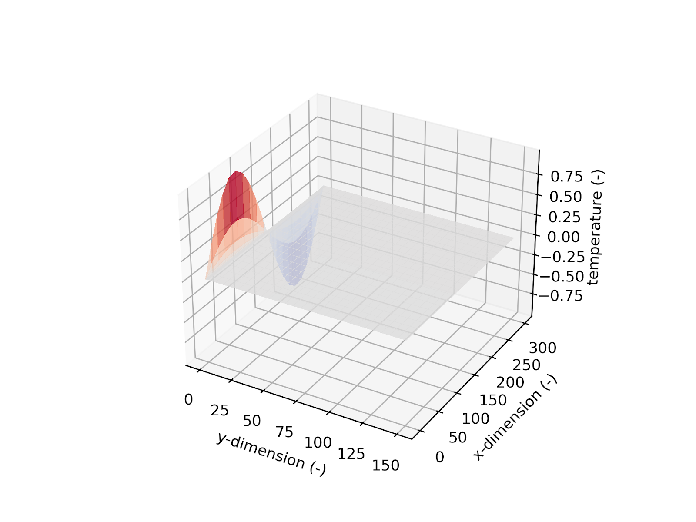
Solution and results. Steady state.
Section title
Different boundary conditions (2D solver)
Figure 5. Steady state distributions of temperature (left) and pressure (right) with different boundary conditions at the bottom
11/18

Slide 13
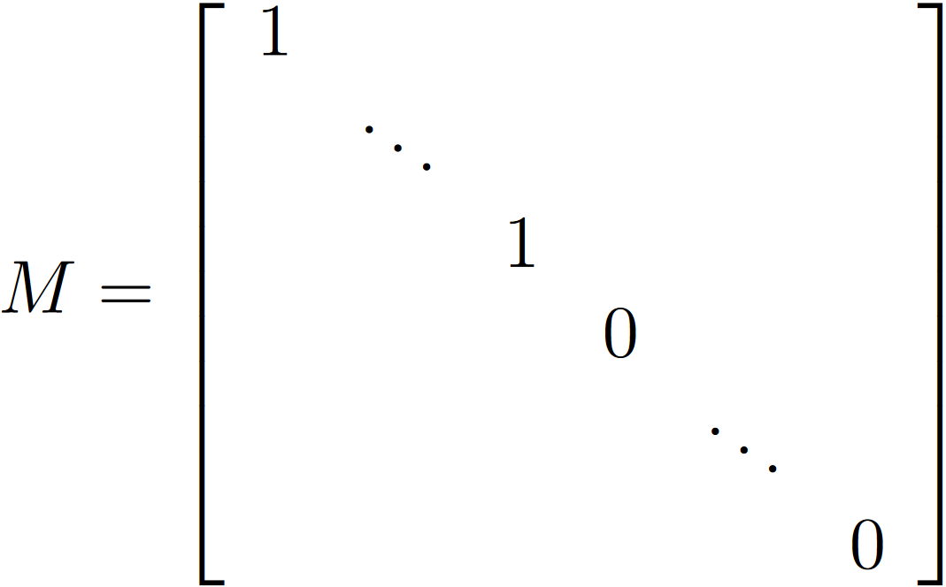
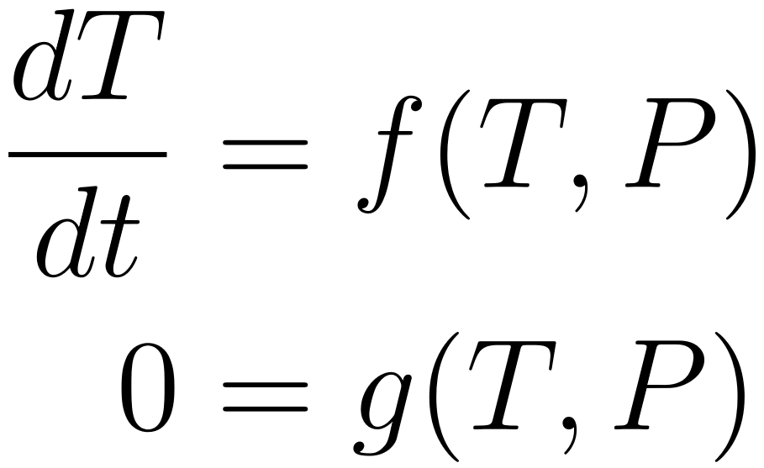
Solution and results. Transient.
Section title
To get the transient solution, we solved a DAE system:
12/18

Slide 14

Solution and results. Transient.
Section title
One step methods:
Implicit Euler
Radau2A
Rodas5
Multistep methods:
BDF (IDA)
Implemented through DifferentialEquations.jl package
13/18

Slide 15
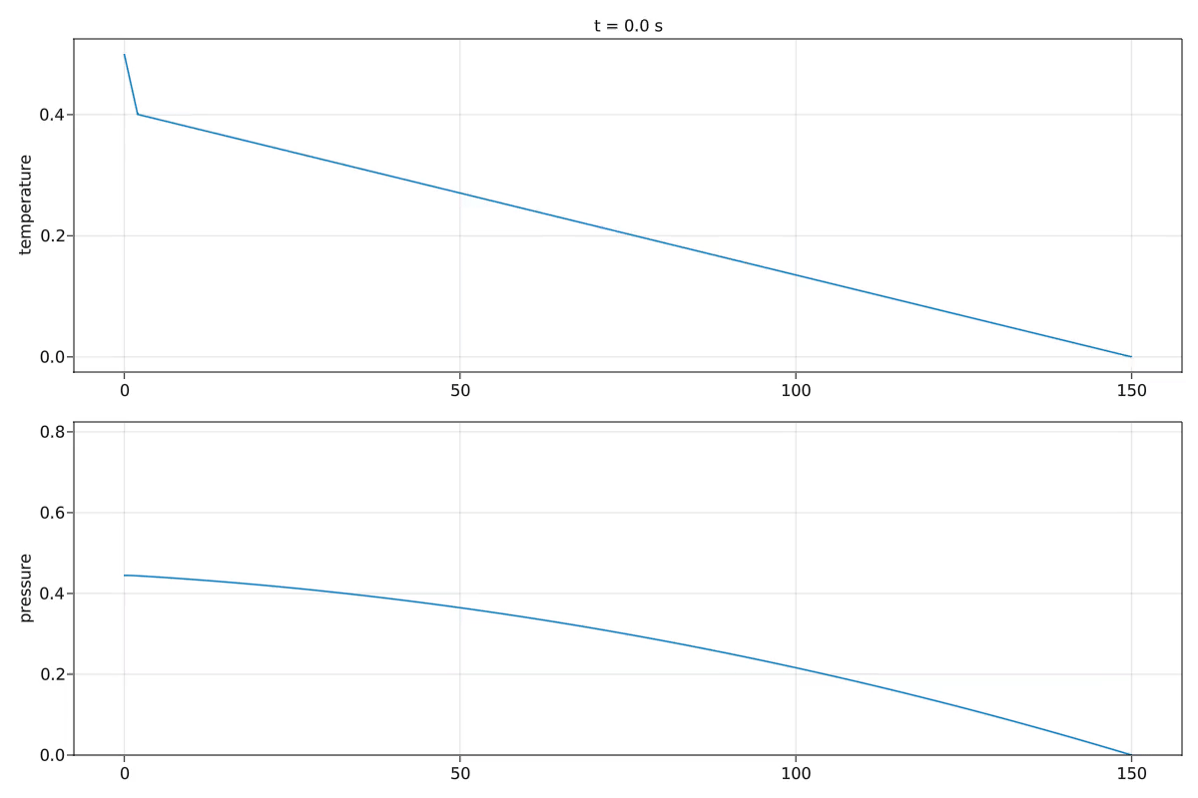
Solution and results. Transient.
Section title
Figure 6. Transient solution
14/18

Slide 16
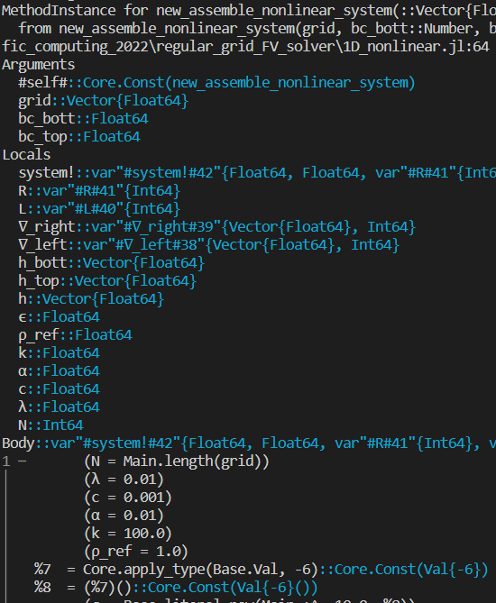
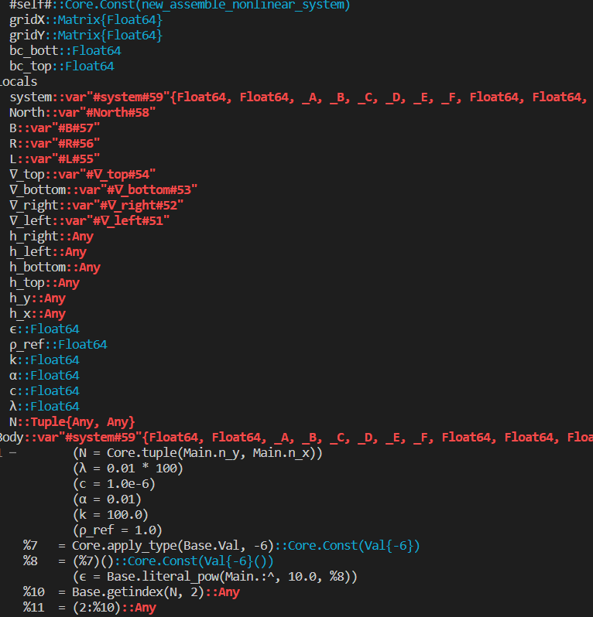
Discussion. Code optimization.
Section title
Type instability: 1D code is type stable, 2D is not
Figure 7. Type instability error screenshots
15/18

Slide 17


Discussion. Code optimization.
Section title
Jacobian sparsity + Automatic differentiation
Figure 8. Jacobian sparsity patterns for 1D (left) and 2D (right)
16/18

Slide 18
Discussion. Disadvantages of our solver.
Section title
Case-focused
Limited mesh refinement capabilities (1 flow source per boundary in each cell)
Not optimized for 2D yet, so time solving with fine meshes is prohibitive
Type instability
17/18

Slide 19
Conclusions
Section title
Darcy’s equations have been solved using FVM
Custom (own code) FVM solver has been developed.
For simple boundary conditions the solution only varies along one axis, therefore 1D simulations are sufficient.
It is found that temperature field has a sharp gradient (boundary layer) near the heated surface, while the rest of the domain remains at the low temperature
2D solver is validated for steady case
Transient solution is found by solving a resulting DAE with Implicit Euler, Radau2A, Rodas5 and BDF methods
As future improvement, the code for 2D will be written to fully take advantage of sparse Jacobians. Parallelization and AMR would also increase the solver’s performance.
18/18

